Slide 1
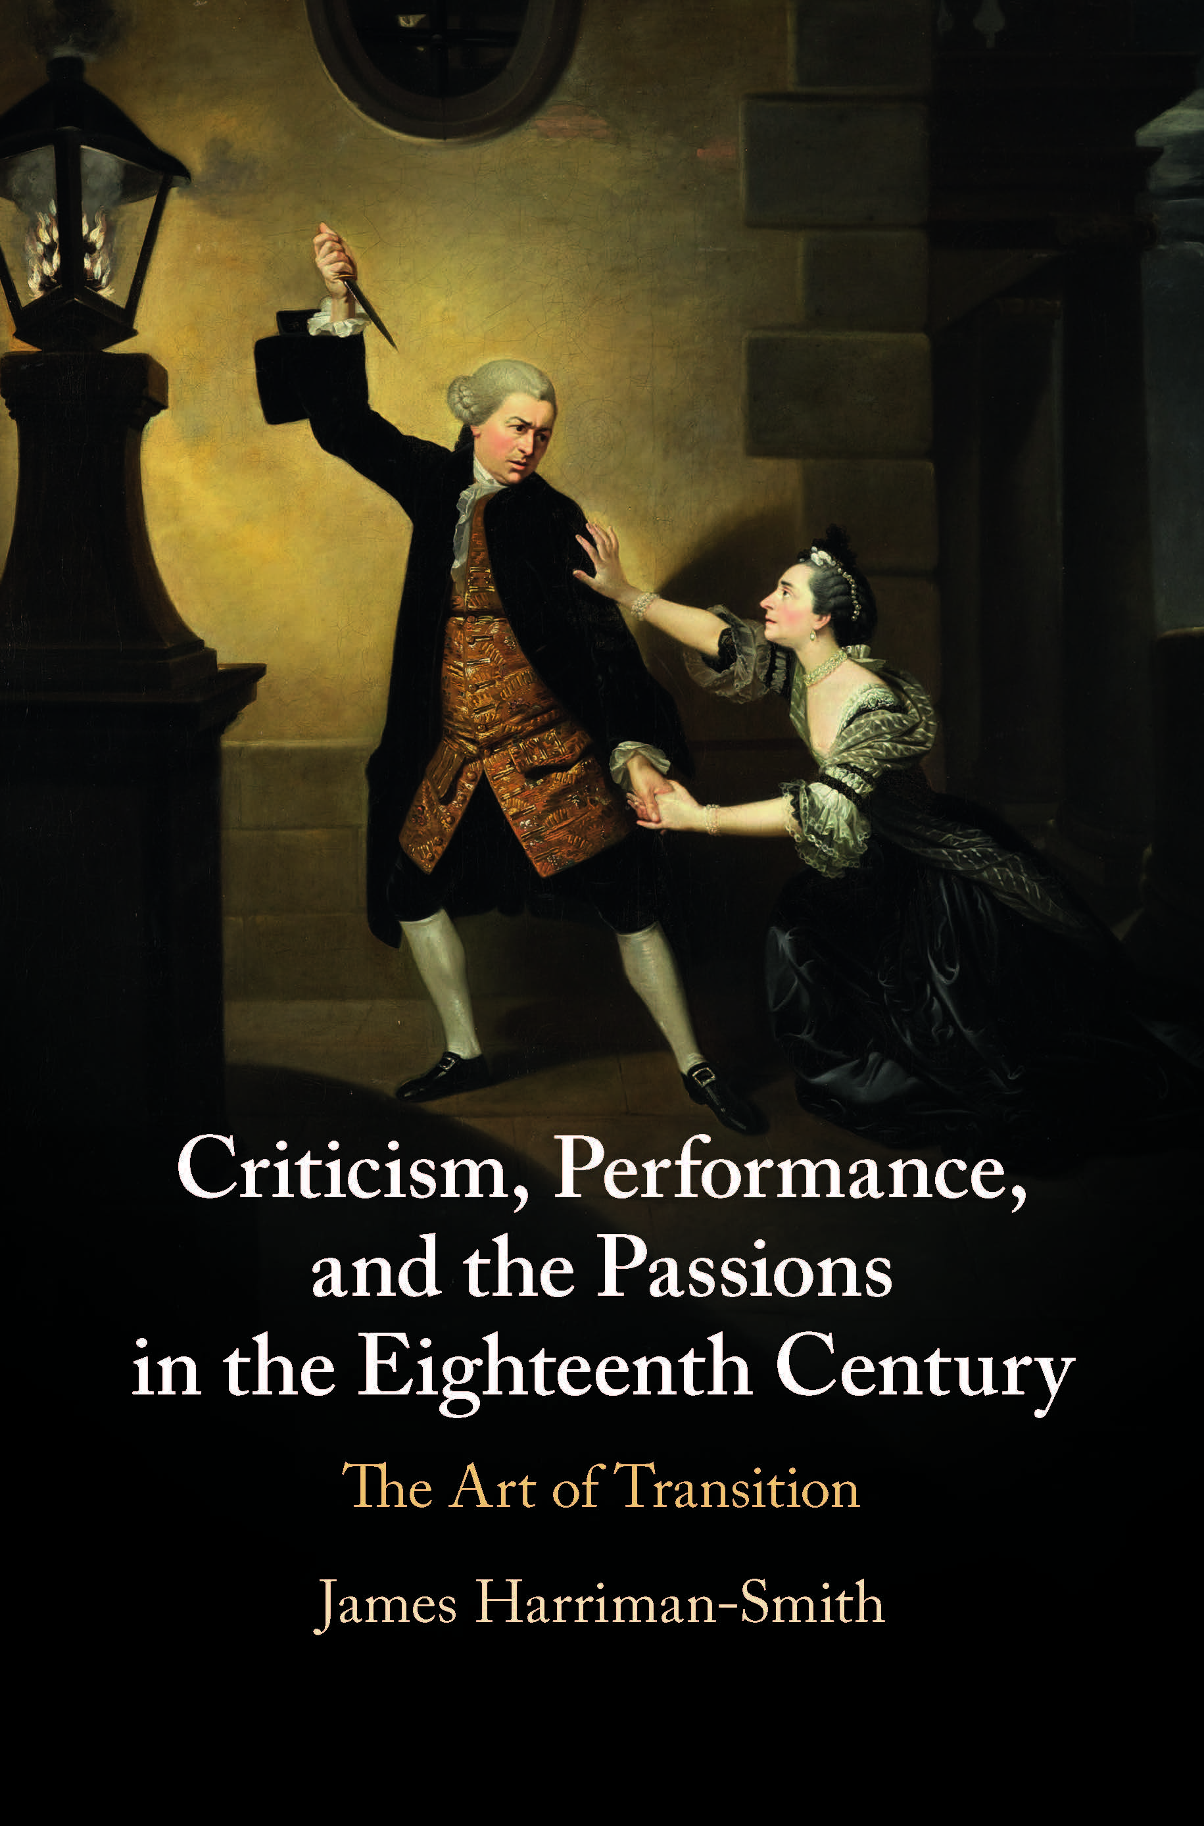
Easy Transitions and Amazing Transitions: Garrick, Hume, and Dramatic Character
Oxford Eighteenth-Century Literature and Culture Seminar
1 June 2021
james.harriman-smith@ncl.ac.uk

Slide 2
1710 1811
[Thomas Betterton was] a Man … from whose Action I had received more strong Impressions of what is great and noble in Human Nature, than form the Arguments of the most solid Philosophers, or the Descriptions of the most charming Poets I had ever read.
Richard Steele, ‘From my own Apartment’, Tatler, 4 May 1710.
…the Lear of Shakespeare cannot be acted. … On the stage we see nothing but corporal infirmities and weakness, the impotence of rage: while we read it, we see not Lear, but we are Lear, - we are in his mind …
Charles Lamb, ‘On Garrick and Acting’, The Reflector, 1811

Slide 5
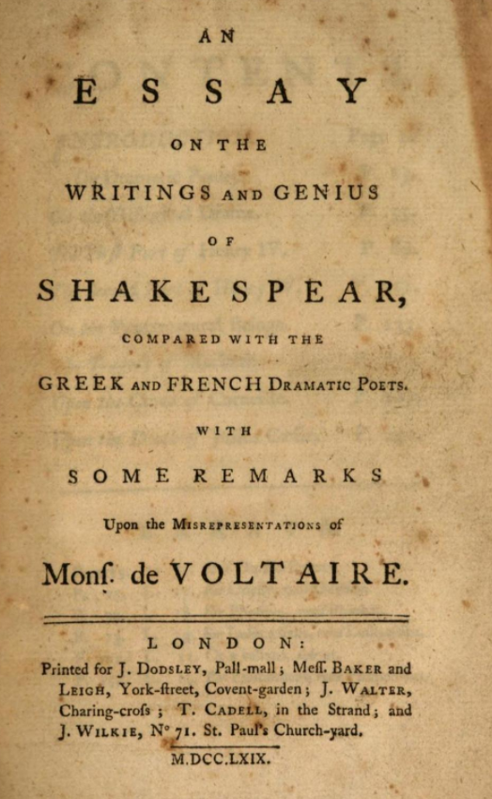
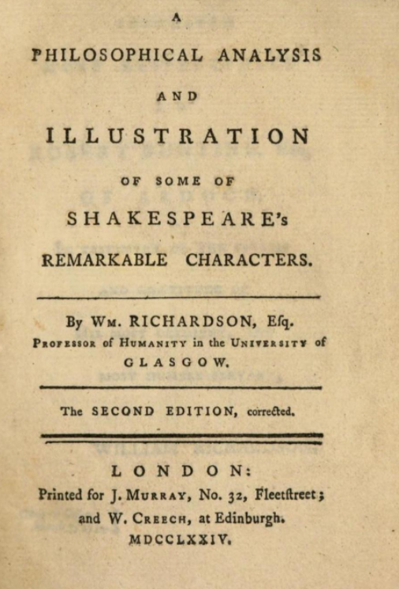
The Selfhood of Shakespeare’s Characters
Elizabeth Montagu, Essay on the Writing and Genius of Shakespeare, 1769, p. 81
William Richardson, A Philosophical Analysis and Illustration of Some of Shakespeare’s Remarkable Characters, 1774, p. 38
Shakespeare’s dramatic personae are men, frail by constitution, frail by constitution, hurt by ill habits, faulty and unequal. But they speak with human voices, are actuated by human passions, and are engaged in the common affairs of human life. We are interested in what they do, or say, by feeling every moment that they are of the same nature as ourselves.
Possessing extreme sensibility, and uncommonly susceptible, he is the Proteus of the drama; he changes himself into every character, and enters easily into every condition of human nature.

Slide 6
The Selfhood of Shakespeare’s Characters
[In Macbeth Shakespeare] exhibits the movement of the human mind, and renders audible the silent march of thought: traces its modes of operation in the course of deliberating, the pauses of hesitation, and the small acts of decision: shews how reason checks, and how the passions impel; and displays to us the trepidations that precede, and the horrors that pursue acts of blood.
Montagu, pp. 183-4
‘Resemblance’

Slide 7
The Selfhood of Shakespeare’s Characters
‘Causation’

Slide 8
Overview
I
Hume evokes the theatre as a space of ‘flux’, where several perceptions successively make their appearance.
This seems to share much with eighteenth-century writing that treats the theatre as a space of amazing transitions.
But such writing about amazing transitions appreciates them as moments that are not only iconic, but dynamic also: the very Instant of the changing Passion.
This might be why Hume retreats from his comparison of the mind to a theatre. It must not mislead us.
Hume’s Treatise actually shows how what he calls ‘easy transitions’ between perceptions – whose ease depends on principles of resemblance, contiguity and causation, trick us into attributing identity to successions of objects that are actually diverse, and this includes even our own personal identity, our selfhood.
Some theatre writers, like Thomas Davies, do just this: they recognize powerful iconic moments in performance but also, in tracing the dynamics of these moments, claim that the actor has captured fundamental elements of the character and of human nature.
A delicate and fascinating balance exists between the vertigo induced by an amazing succession of extreme passions and the possibility that the actor just might be able to hold them together.
This delicate balance is upset in the early character criticism of Montagu and Richardson. Both scour Shakespeare’s writing to bring together individual, amazing transitions in them through claims of resemblance and causation.
Their arguments thus construct Shakespeare’s characters as though possessed of a self. As such they are doing the precise opposite of what Hume is doing: while Hume appeals to the flux of the stage, Montagu and Richardson seek to systematize it.
II
III

Slide 9
1710 1811
[Thomas Betterton was] a Man … from whose Action I had received more strong Impressions of what is great and noble in Human Nature, than form the Arguments of the most solid Philosophers, or the Descriptions of the most charming Poets I had ever read.
Richard Steele, ‘From my own Apartment’, Tatler, 4 May 1710.
…the Lear of Shakespeare cannot be acted. … On the stage we see nothing but corporal infirmities and weakness, the impotence of rage: while we read it, we see not Lear, but we are Lear, - we are in his mind …
Charles Lamb, ‘On Garrick and Acting’, The Reflector, 1811

Slide 10
Thank you for listening!

Slide 11
I
…several perceptions successively make their appearance; pass, re-pass, glide away, and mingle in an infinite variety of postures and situations…

Slide 12
…several perceptions successively make their appearance; pass, re-pass, glide away, and mingle in an infinite variety of postures and situations…
I
Mr. Garrick steps forward and beggars description, by an amazing variety of transitions, tones and picturesque attitudes; the distracted confusion which flames in his countenance, and the gleams of love which shed momentary softness on the stern glow of rage, exhibit more complicated beauties than any other piece of theatrical execution we have seen.
Francis Gentleman, Dramatic Censor, v.1, p. 335

Slide 13
…several perceptions successively make their appearance; pass, re-pass, glide away, and mingle in an infinite variety of postures and situations…
I
Zoffany, Johan, David Garrick as Jaffier and Susannah Cibber as Belvidera in ‘Venice Preserv’d’ by Thomas Otway, 1763, oil on canvas

Slide 14
…several perceptions successively make their appearance; pass, re-pass, glide away, and mingle in an infinite variety of postures and situations…
I
‘how are we surprised at the wild exertion of her powers in the sudden transitions [that Susannah Cibber] makes from love and grief to the extremities of rage and despair!’
Thomas Wilkes, General View, 1759, p. 279

Slide 15
…several perceptions successively make their appearance; pass, re-pass, glide away, and mingle in an infinite variety of postures and situations…
I
He stops short, upon pensive Pauses, and makes Transitions, (as the Meanings vary) into Jealousy, Scorn, Fury, Penitence, Revenge or Tenderness! All, kindled at the Eye, by the Ductility of a Flexible Fancy, and appropriating Voice and Gesture, to the very Instant of the changing Passion.
Aaron Hill, The Prompter, 27 June 1735

Slide 16
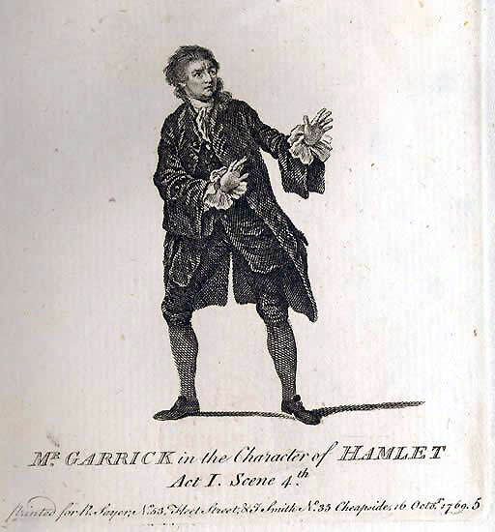
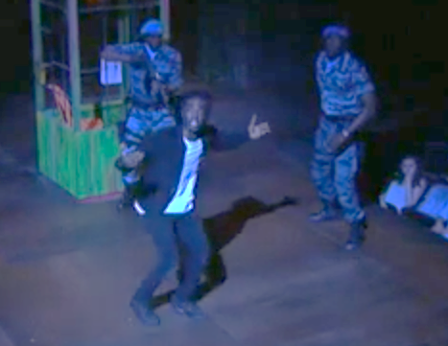
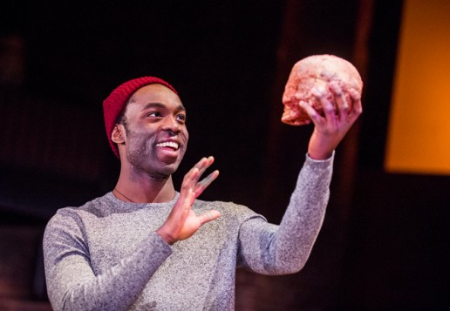
…several perceptions successively make their appearance; pass, re-pass, glide away, and mingle in an infinite variety of postures and situations…
I
…the very Instant of the changing Passion.

Slide 17
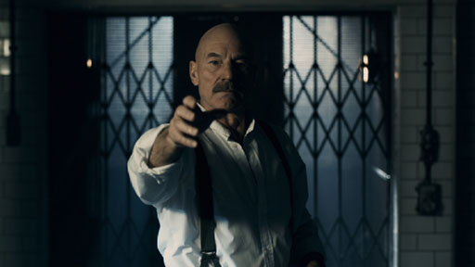
…several perceptions successively make their appearance; pass, re-pass, glide away, and mingle in an infinite variety of postures and situations…
I
…the very Instant of the changing Passion.

Slide 18
…several perceptions successively make their appearance; pass, re-pass, glide away, and mingle in an infinite variety of postures and situations…
I
…the very Instant of the changing Passion.

Slide 19
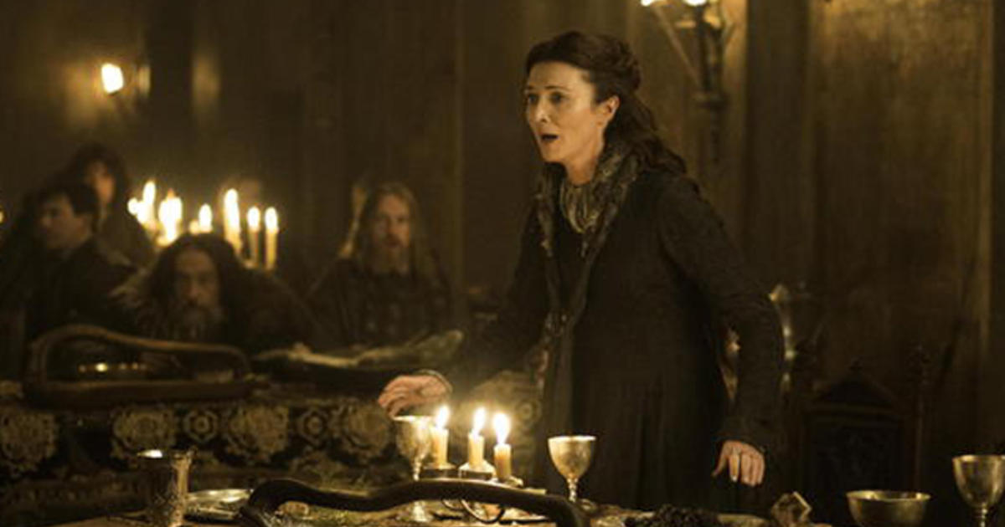
…several perceptions successively make their appearance; pass, re-pass, glide away, and mingle in an infinite variety of postures and situations…
I
…the very Instant of the changing Passion.

Slide 20
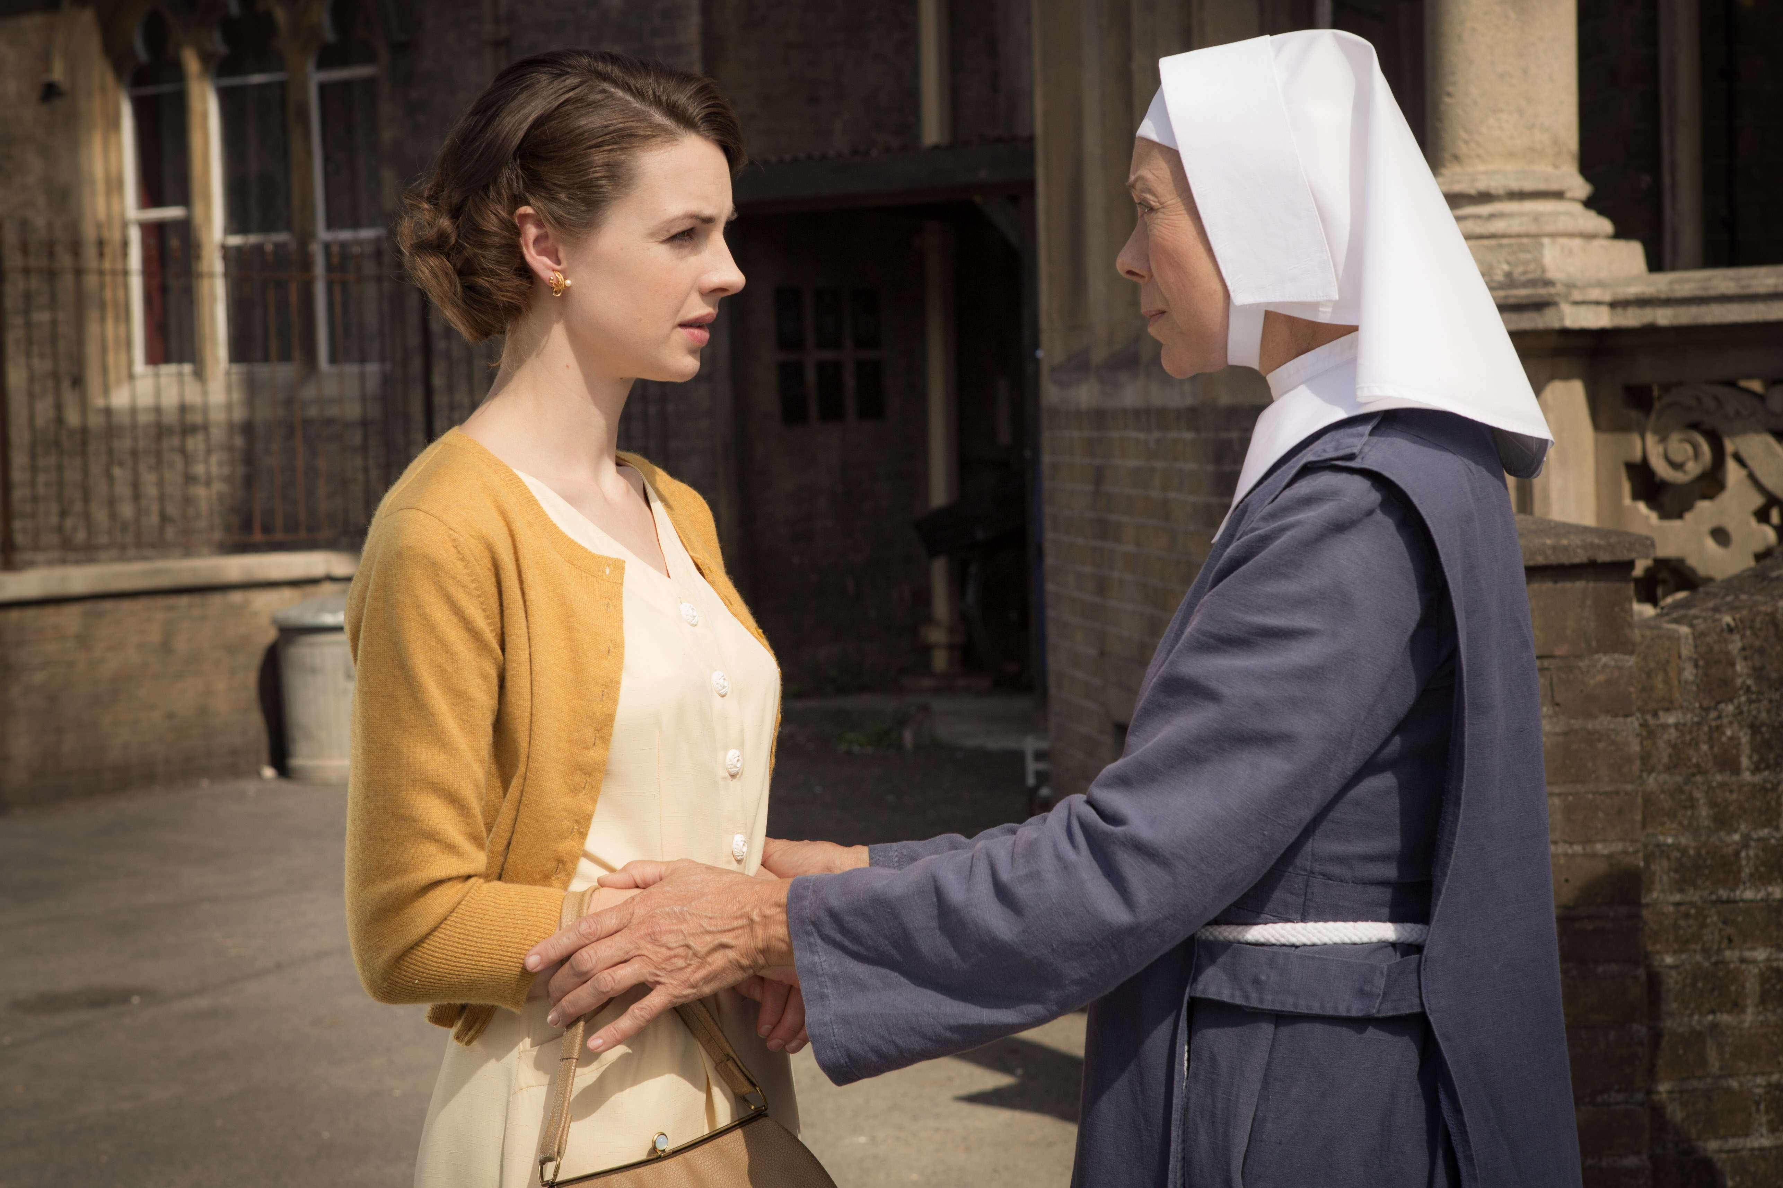
…several perceptions successively make their appearance; pass, re-pass, glide away, and mingle in an infinite variety of postures and situations…
I
…the very Instant of the changing Passion.

Slide 21
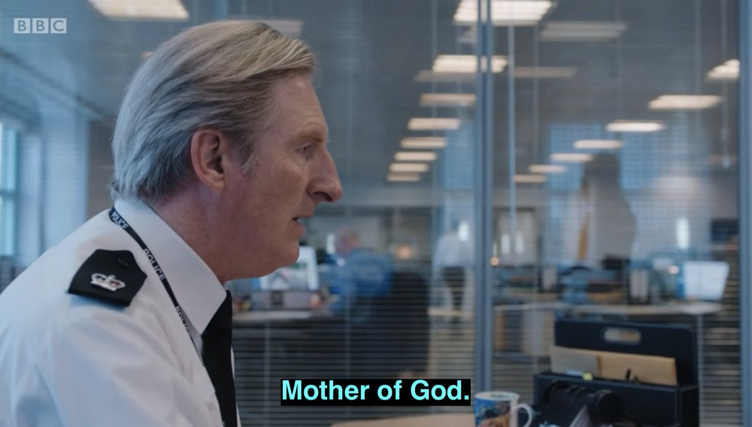
…several perceptions successively make their appearance; pass, re-pass, glide away, and mingle in an infinite variety of postures and situations…
I
…the very Instant of the changing Passion.

Slide 22
II
There is properly no simplicity in [the mind] at one time, nor identity in different; whatever natural propension we may have to imagine that simplicity and identity…

Slide 23
There is properly no simplicity in [the mind] at one time, nor identity in different; whatever natural propension we may have to imagine that simplicity and identity…
II
Two ways of thinking about objects:
‘a distinct idea of an object, that remains invariable and uninterrupted through a supposed variation of time; and this idea we call that of identity or sameness’
‘a distinct idea of several different objects existing in succession, and connected together by a close relation; and this to an accurate view affords as perfect a notion of diversity, as if there was no manner of relation among the objects’
The problem is that we confuse A and B in our ‘common way of thinking’
We have a ‘natural propension’ to imagine ‘simplicity and identity’ where it does not exist…

Slide 24
There is properly no simplicity in [the mind] at one time, nor identity in different; whatever natural propension we may have to imagine that simplicity and identity…
II
Why do we confuse things and imagine identity where there is diversity?
When we ‘reflect on the succession of related [diverse] objects’…
‘The relation facilitates the transition of the mind from one object to another, and renders its passage as smooth as if it contemplated one continued object.’
It is the ‘easy transition’ between objects that means that we treat them as a simple and identical.

Slide 25
There is properly no simplicity in [the mind] at one time, nor identity in different; whatever natural propension we may have to imagine that simplicity and identity…
II
What makes transitions between objects so easy that we give in to our natural propension and treat that a diverse succession as one identity?
Resemblance
Contiguity
Causation

Slide 26
There is properly no simplicity in [the mind] at one time, nor identity in different; whatever natural propension we may have to imagine that simplicity and identity…
II
What makes transitions between objects so easy that we give in to our natural propension and treat that a diverse succession as one identity?
Resemblance

Slide 27
There is properly no simplicity in [the mind] at one time, nor identity in different; whatever natural propension we may have to imagine that simplicity and identity…
II
What makes transitions between objects so easy that we give in to our natural propension and treat that a diverse succession as one identity?
Contiguity

Slide 28
There is properly no simplicity in [the mind] at one time, nor identity in different; whatever natural propension we may have to imagine that simplicity and identity…
II
What makes transitions between objects so easy that we give in to our natural propension and treat that a diverse succession as one identity?
Causation
‘a sympathy of parts to their common end, and suppose that they bear to each other, the reciprocal relation of cause and effect in all their actions and operations’

Slide 29
There is properly no simplicity in [the mind] at one time, nor identity in different; whatever natural propension we may have to imagine that simplicity and identity…
II
‘It is, therefore, on some of these three relations of resemblance, contiguity and causation, that identity depends; and as the very essence of these relations consists in their producing an easy transition of ideas; it follows, that our notions of personal identity, proceed entirely from the smooth and uninterrupted progress of the thought along a train of connected ideas, according to the principles above-explained.’ – i.e.:
Resemblance
Causation

Slide 30
There is properly no simplicity in [the mind] at one time, nor identity in different; whatever natural propension we may have to imagine that simplicity and identity…
II
‘…the very essence of these relations consists in their producing an easy transition of ideas…’ ➔ a belief in ‘identity’
Even for our sense of self:
our memory of past perceptions would ‘contribute to the bestowing a relation on this succession amidst all its variations’
Resemblance
Causation

Slide 31
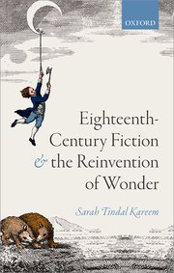
Summary of Key Points
II
Hume forces us to recognize ‘easy transitions’ between perceptions.
What we thought was identity no longer seems to be.
This is one way that Hume’s scepticism is a means ‘to render the taken-for-granted world briefly available as an object of wonder.’
We are all making easy transitions right now.
Easy transitions help induce a belief in identity.
They create identity.

Slide 32
III
The comparison of the theatre must not mislead us. They are the successive perceptions only, that constitute the mind; nor have we the most distant notion of the place, where these scenes are represented, or of the materials, of which it is composed.

Slide 33
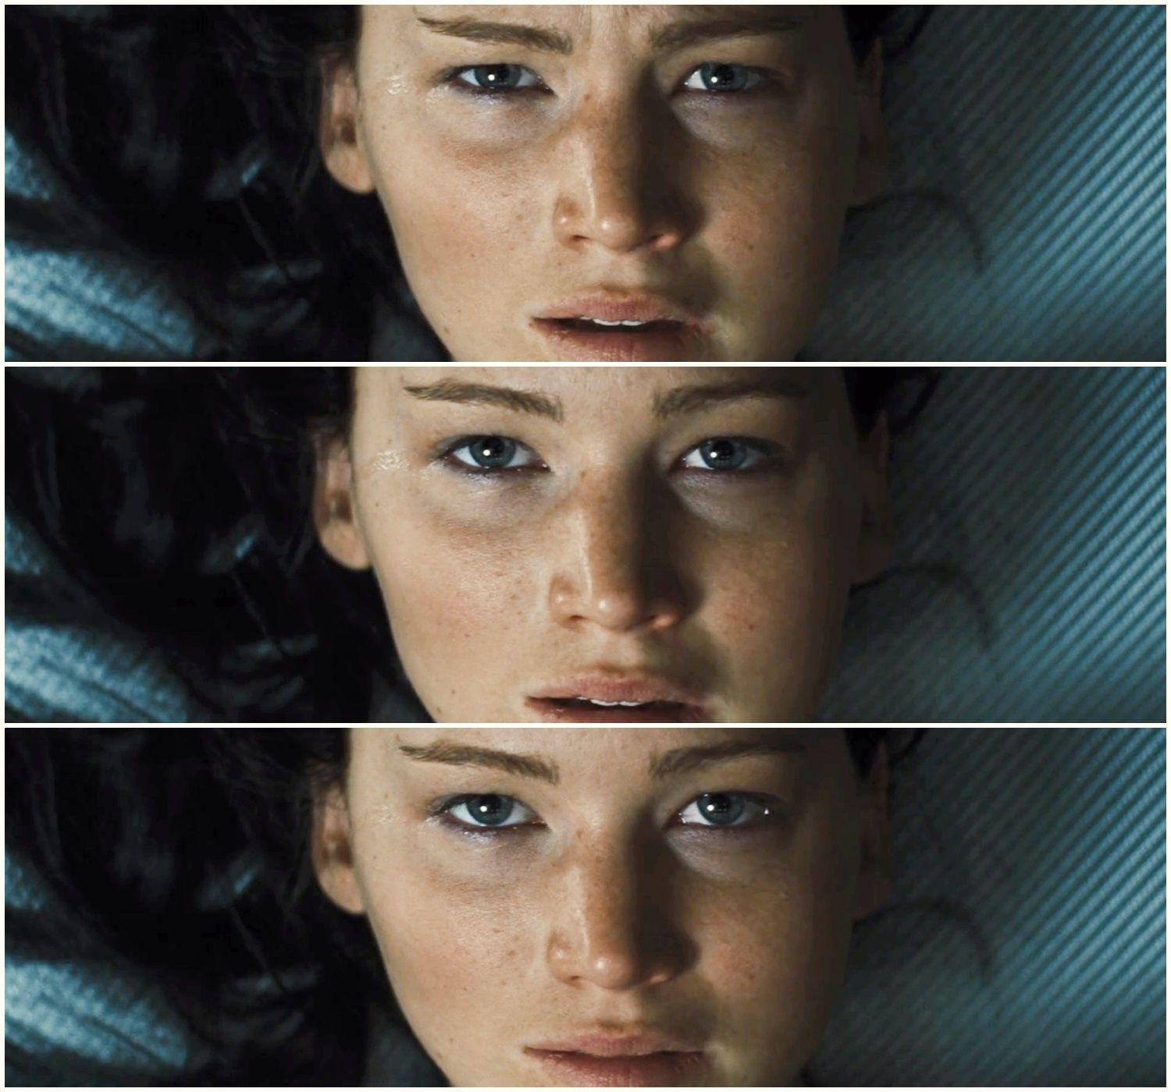
The comparison of the theatre must not mislead us. They are the successive perceptions only, that constitute the mind…
III
Why does Hume retreat from a comparison between the theatre and the mind?
His comparison is selective:
Evokes its ‘amazing transitions’:
But fears the way the theatre invites us to give in to our ‘natural propension’ and treat actor’s transitions as though they created identity.

Slide 34
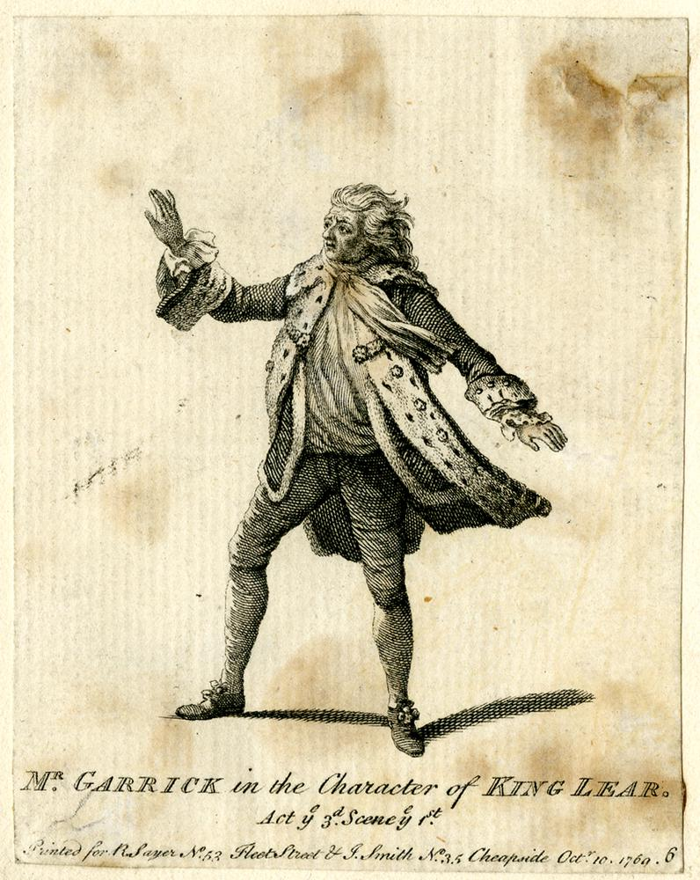
The comparison of the theatre must not mislead us. They are the successive perceptions only, that constitute the mind…
III
‘In the preceding scenes of Lear, Garrick had displayed all the force of quick transition from one passion to another: he had, from the most violent rage, descended to sedate calmness; had seized, with unutterable sensibility, the various impressions of terror, and faithfully represented all the turbid passions of the soul; he had pursued the progress of agonizing feelings to madness in its several stages.’
Thomas Davies, Dramatic Miscellanies, 1784, vol. 2, p. 208

